Slide 1

Demos 101, Pgh. Tech Fest 2017 Phil Van Sickel, Sr Agile Coach

Slide 2
Demo Retrospective
Why did you come?
What issues are you having with your demos?
Have you ever experienced This?
Tell us about your worst demo.

Slide 3
Definitions
Four demo types
Acceptance Demo
Sprint or Team Demo
Integrated or System Demo
Program or Release Demo

Slide 4
Acceptance Demo
Purpose: To enable the Product Owner to accept a story
Audience: Product Owner
Scope: All acceptance criteria for a story
Delivered By: Tester or developer

Slide 5
Sprint or Team Demo
Purpose: To review completed stories for a sprint in order to identify enhancements or changes
Audience: The team and invited stakeholders
Scope: All completed stories but not all acceptance criteria, focus on areas where feedback is most important
Delivered By: The team

Slide 6
System or Integrated Demo
Purpose: To show completed features for a sprint to all interested stakeholders to solicit feedback and to inform them of completed work.
Audience: Product Owners and all stakeholders to a program
Scope: All completed features from the previous sprint within a larger program of multiple teams
Delivered By: The Product Owners

Slide 7
Program or Release Demo
Purpose: recognize and celebrate what was completed in the program increment or release
Audience: Everyone in the program
Scope: All completed features from the previous program increment or release, constrain scope to key accomplishments (Time box)
Delivered By: The teams

Slide 8
Demo best practices
We want to focus on
Sprint or Team Demo
Integrated or System Demo
These are the critical demos for soliciting feedback and making course corrections
Demo
Notes:
Add hyperlink to an excel spreadsheet.

Slide 9

Establish the context for your demo
What is the bigger picture?
I can get lost in the trees and not see the forest.
Give your audience enough background to understand what they are seeing.
Notes:
Add hyperlink to an excel spreadsheet.

Slide 10

Have your demo tell a story
What is the point of this demo?
Why would I care?
What’s in it for me?
Notes:
Add hyperlink to an excel spreadsheet.

Slide 11

Show how your demo fits into the final solution
You are often showing pieces of an incomplete process
Include prototypes of the missing elements
Notes:
Add hyperlink to an excel spreadsheet.

Slide 12

Follow one user scenario at a time
Switching context may be faster and easier for the presenter but it causes the attender to get confused
They have to mentally imagine the scenarios
Notes:
Add hyperlink to an excel spreadsheet.

Slide 13
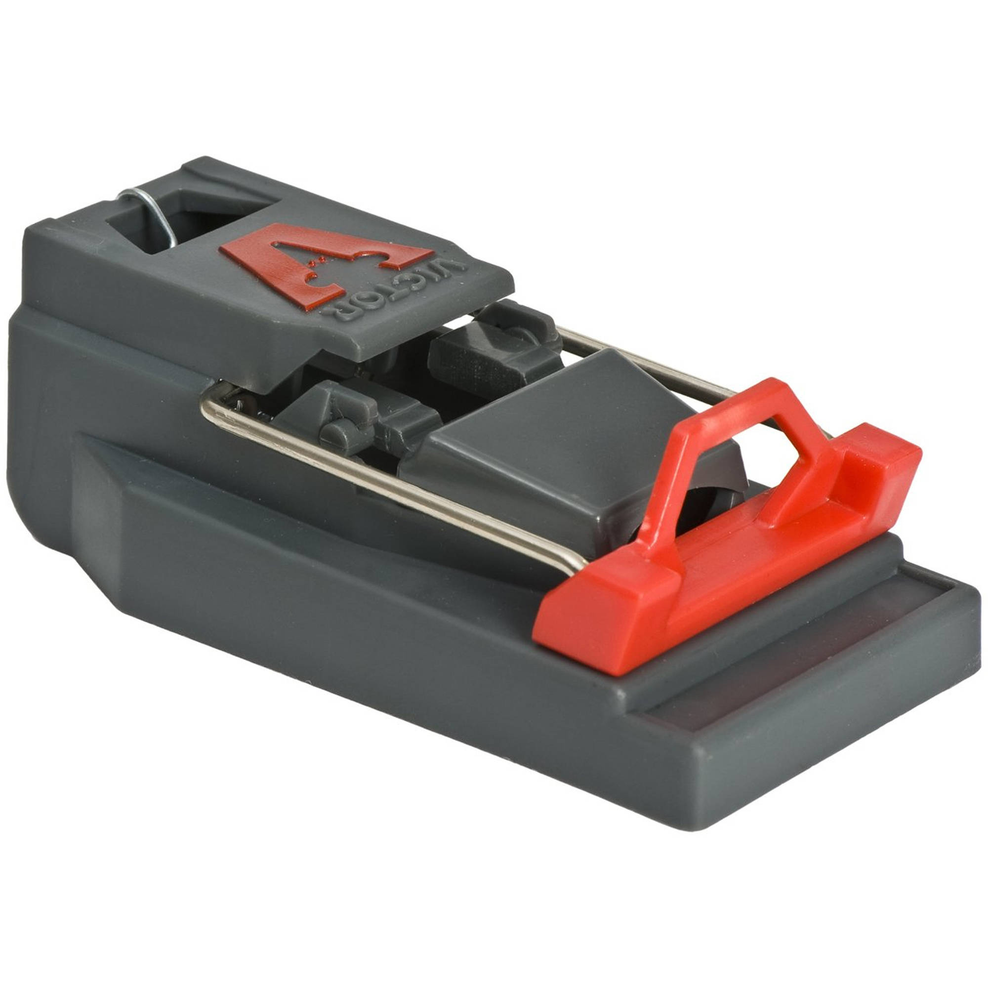
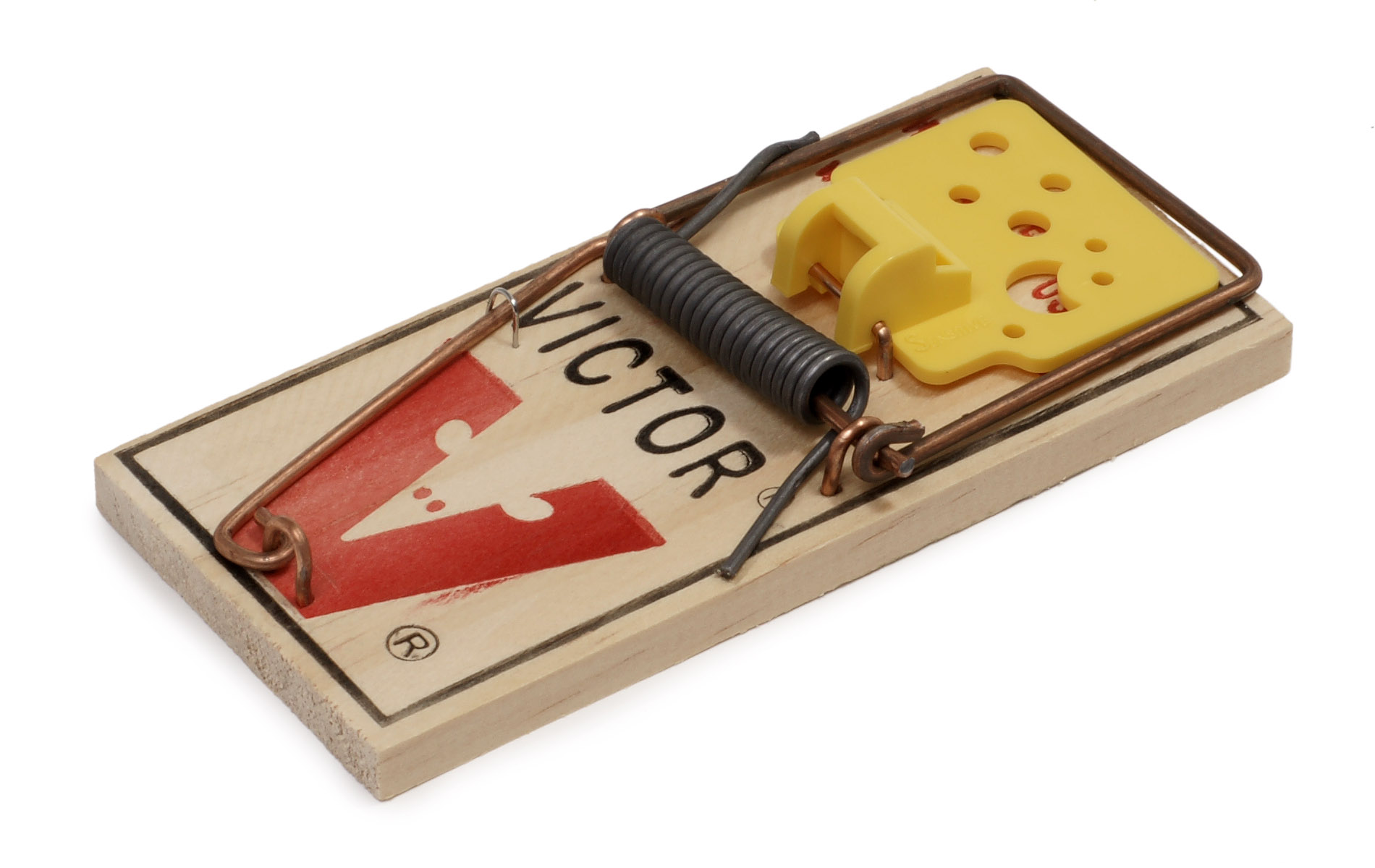
Clearly identify the problem the solution is trying to solve
Why is this better than what they used to do
Perhaps the benefit is to the organization and not the direct user
Notes:
Add hyperlink to an excel spreadsheet.

Slide 14

Practice your demo
Nothing worse than fumbling around in front of 30 busy people
This ensures you know how to stage the data for the demo
Notes:
Add hyperlink to an excel spreadsheet.

